Slide 1
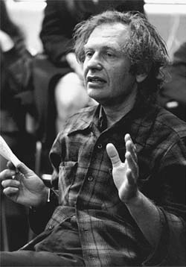
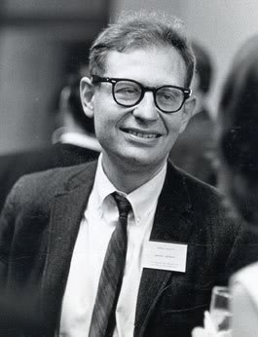
Lawrence Kohlberg
1927-1987
http://www.education.com/reference/article/kohlberg-lawrence-1927-1987/
http://relong.myweb.uga.edu/
“The individual makes a clear effort to define moral values and principles that have validity and application apart from the authority of the groups of persons holding them and apart from the individual's own identification with the group”

Slide 2
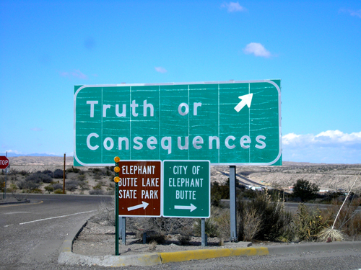
Level One: Preconventional Morality Stage one: Obedience and Punishment Orientation
Knowledge of set rules
Recognize and follow authority
Concerned with consequences and punishment
Preconventional thinking
http://www.deborahshanetoolbox.com/wp-content/uploads/2010/05/golden-rule.jpg
http://www.legendsofamerica.com/nm-truthconsequence.html
http://han-liang.blogspot.com/2011/03/kohlbergs-stages-of-moral-development.html

Slide 3
Stage two: Individualism and Exchange
Isolated - individual way of thinking
Start to realize that there is more than one “right way” of doing things
Minimally appreciate different viewpoints
Only does something to get something
“If you scratch my back, I’ll scratch yours.”
http://static.photaki.com/isolated--kid--hands-up-458489.jpg

Slide 4
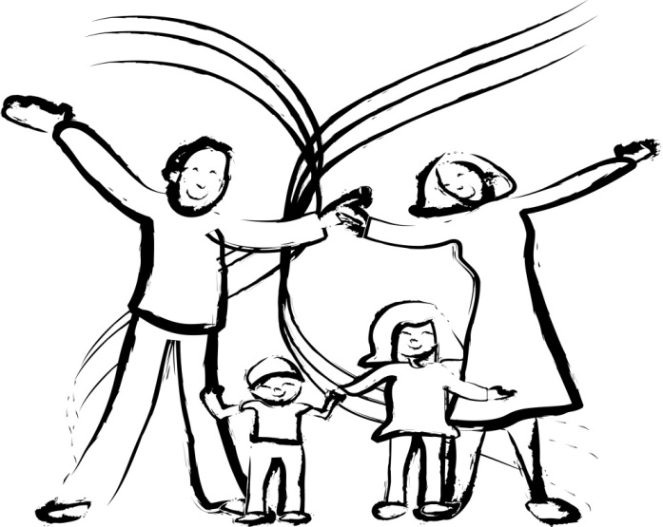
Level two: Conventional Morality Stage three: Good Interpersonal Relationships
Expectations of one’s family & community are extremely important
What society expects as “good” behavior
Need for approval of peers
http://www.youtube.com/watch?v=riugWInqiaE
http://how-to-keep.net/wp-content/uploads/2011/02/how-to-keep-family-bonds.jpg
http://www.ehow.co.uk/how_4732368_reward-good-behavior-children-food.html

Slide 5
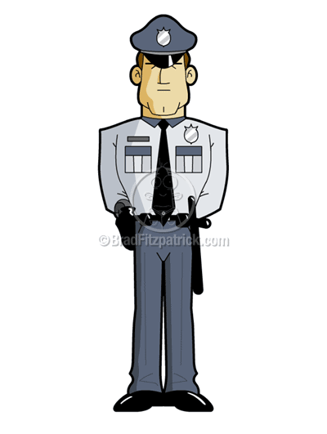
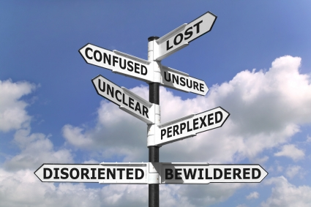
Stage four: Maintaining the Social Order
Makes moral decisions based on society
Maintaining social order
Obeying laws because it’s what makes society function properly
http://www.ideachampions.com/weblogs/archives/2010/03/a_good_decision.shtml

Slide 6
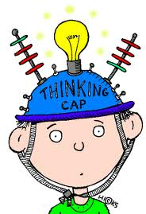
Level three: Post conventional Morality Stage five: Social Contract and Individual Rights
Think about society in a theoretical way
Rights and values of societies are more important than self
See changes can be made to rules to benefit their society
Right actions can be a matter of personal values and opinions
http://math.pppst.com/problemsolving.html
http://10.104.1.249/block/restricted.html?fn=HS&fp=6&ip=10.161.142.145&ibip=10.104.1.229&ldu=0&re=0&bu=funyug.com/wp-content/uploads/2011/06/animatedthinkingcap.gif&bc=Website%20contains%20prohibited%20Friendship%20content.

Slide 7
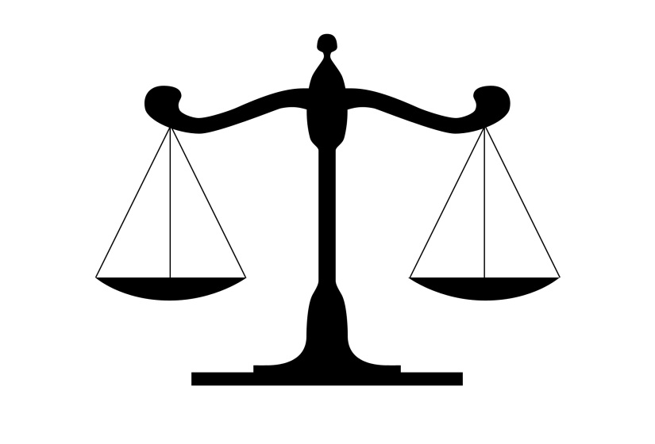
Stage six: Universal Principles
Make decisions based on their conscience
Self-ethics – what’s right for all
Believe in fairness and justice
Make sure everyone benefits and no one is left out or hurt
http://www.naswil.org/news/networker/featured/self-care-an-ethical-responsibility/

Slide 8
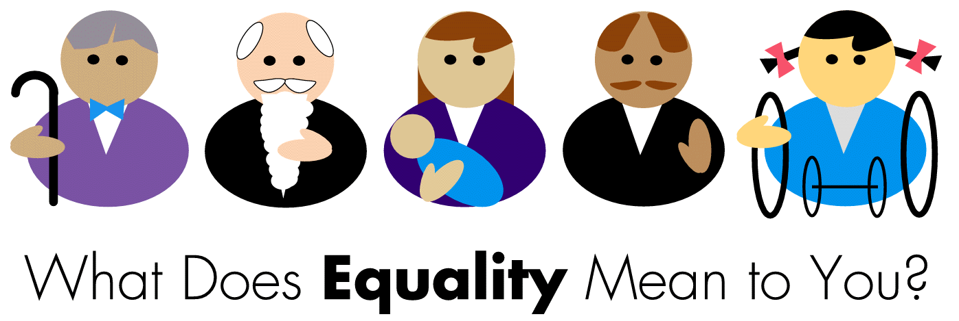
Summary of the six stages
Stage one: right & wrong
Stage two: see everyone has their own opinions and there is more than one right side
Stage three: being a good person in society
Stage four: obeying laws to maintain good society
Stage five: basic rights of individuals
Stage six: equality for all
http://www.rollbackcampaign.org/images/areas/143/NCRCR%20Equality%20Logo%20wLtrsCROPPED.gif

Slide 9
Stages
http://www.usefulcharts.com/psychology/kohlberg-stages-of-moral-development.html

Slide 10
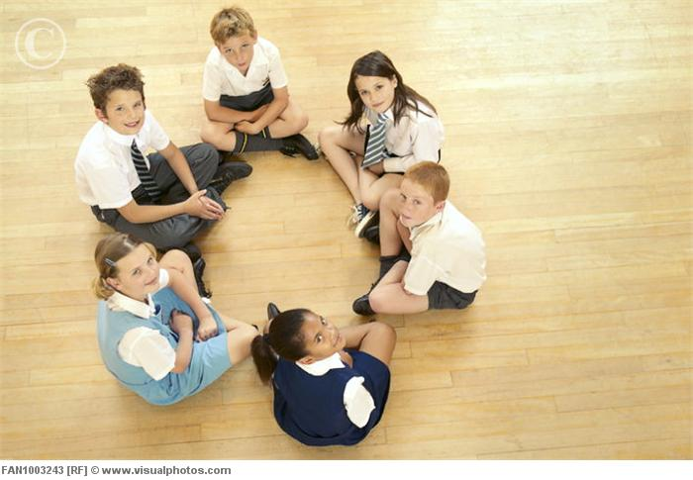
“Just Community” Schools Approach
Democratic community with full participation
Small size
Students entrusted with responsibility
Consensus rather than “majority rules”
Teacher acts as moderator
http://www.visualphotos.com/image/2x1899177/schoolchildren_sitting_in_a_circle

Slide 11
Conclusion
Stages are logical
“Just Community” schools approach seems a little idealistic
Moral education can be controversial
Teachers can have daily/weekly discussion groups
Parents can talk with their kids about issues instead of jumping to discipline

Slide 12
Review Questions
At the pre-conventional level, what characterizes the child’s reasoning?
Actions are motivated by self-interest only.
At the conventional level, what characterizes the child’s reasoning?
Children act to please those closest to them.
At the post-conventional level, what characterizes the child’s reasoning?
Individuals act in accordance to established rules that protect the common good.
What is the role of a teacher in the “just community” schools approach?
A teacher acts a moderator, enforcing the rules and guiding the children to see the holes in their reasoning.
What are ways you can promote moral development in children?
Have discussions of acceptable behaviors and why they are acceptable
MODEL good and appropriate behavior
Discuss why good behavior and care of others is so important

Slide 13
Bibliography
Crain, W C. “Kohlberg’s Stages of Moral Development.” plts. N.p., n.d. Web. 14 Sept. 2011. <http://faculty.plts.edu/‌gpence/‌html/‌kohlberg.html>.
Kohlberg, By Lawrence. “Stages of Moral Development.” NSS Press . N.p., n.d. Web. 15 Sept. 2011. <http://www.nsspress.com/‌braunwarth_reader/‌sec2-01.htm>.
Kohlberg, Lawrence. “Lawrence Kohlberg Quotes.” Brainy Quote. N.p., 2001-2011. Web. 14 Sept. 2011. <http://www.brainyquote.com/‌quotes/‌authors/‌l/‌lawrence_kohlberg.html>.
“Kohlberg’s Stages of Moral Development.” University of Central Florida. N.p., 9 June 2011. Web. 15 Sept. 2011. <http://pegasus.cc.ucf.edu/‌~ncoverst/‌Kohlberg’s%20Stages%20of%20Moral%20Development.htm>.
Long, Robyn, and Roger Thomas. “Lawrence Kohlberg 1927- 1987.” Uga. N.p., n.d. Web. 14 Sept. 2011. <http://relong.myweb.uga.edu>.
Nucci, Larry. “Moral Development and Moral Education: An Overview.” University of Illinois at Chicago. N.p., 2 Dec. 2008. Web. 15 Sept. 2011. <http://tigger.uic.edu/‌~lnucci/‌MoralEd/‌overview.html>.

